Slide 1
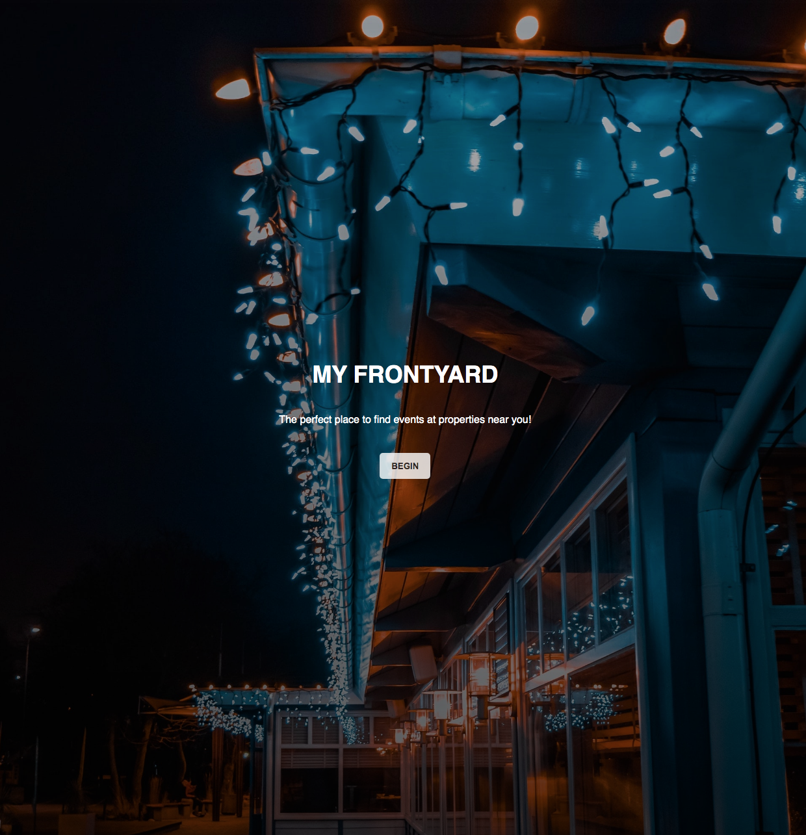
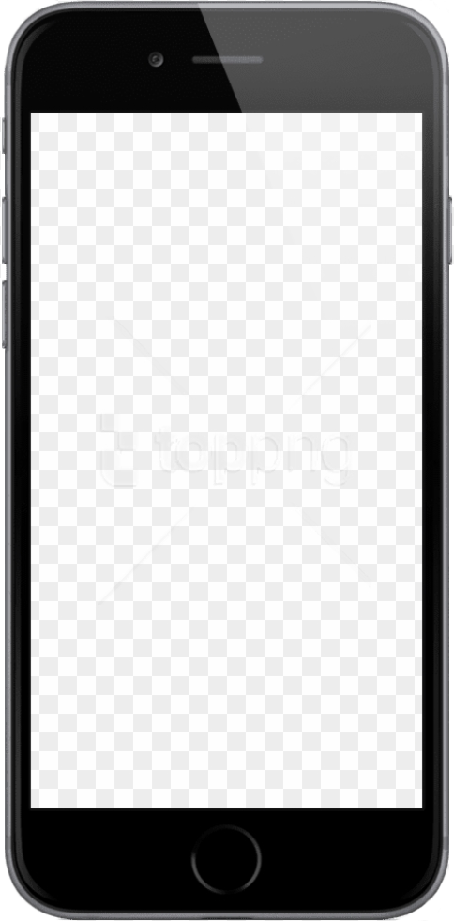
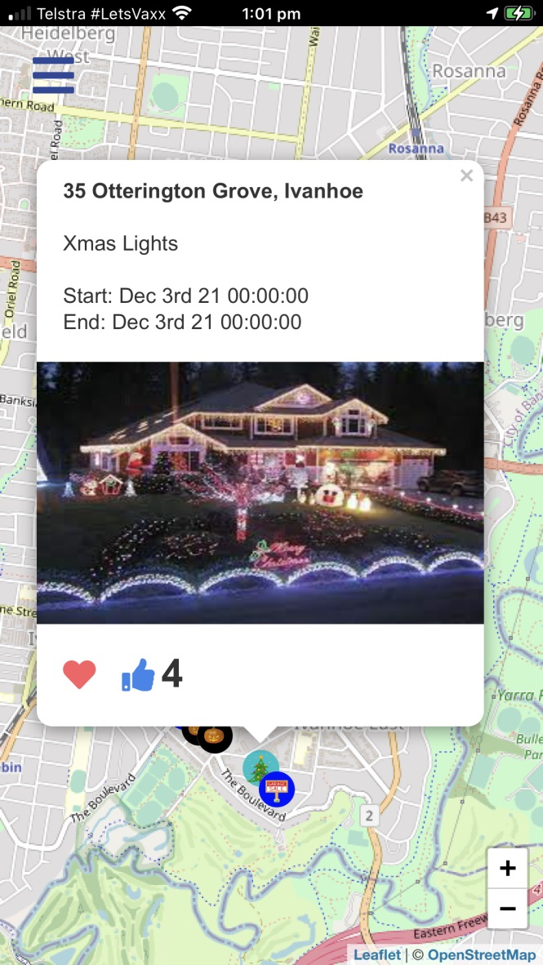




Slide 2
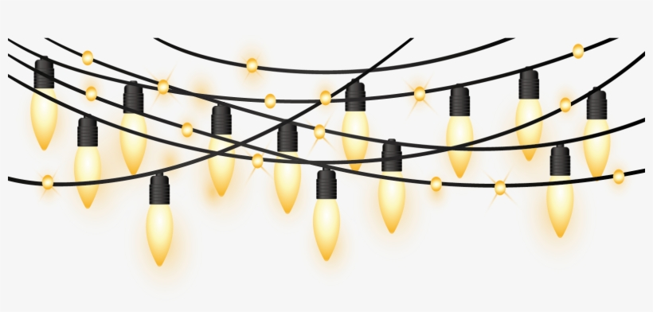
The holiday season is a time for celebration that should be shared with many. Some go above and beyond, creating glamorous christmas displays that deserve to be seen, but not always are. Our team was inspired by this problem to create an app that makes such events easier to find.
Advertising residential events beyond friends and family to the greater public is a problem that does not have a direct solution. That is where My FrontYard comes in.

Slide 3
My FrontYard is an intuitive app designed to allow hosts to advertise their residential events and allows other users to access event information and plan their journey to said events.
These events include:
Christmas light decorations
Halloween decorations
Garage Sales

Slide 4
User Stories
AS A user who wants to locate great christmas decorations in my area
I WANT to instigate a radius based search for properties based on my parameters centred on my location
I WANT to select each search result and see a pop-up containing basic information about the event
I WANT each pop-up to contain the event time, date, location, user likes and a picture of the property
SO I can find relevent properties in my area displaying christmas decorations
AS A user who wishes to advertise their property for a garage sale
I WANT to list the location of my event
I WANT to add a short description about my event
I WANT to specify the time and date of my event
I WANT to display a picture of my property
SO THAT potential customers may come to my event
AS A user that has seen multiple great christmas decorations
I WANT to 'like' outstanding properties
I WANT to favourite these properties
I WANT to view my liked and favourited properties from my account page
SO THAT other users may better see outstanding properties and I can view them in the future
AS A user who wants their information secure
I WANT to be promted to sign up the first time I enter the site
I WANT to save my information, including event details, my name, my address and my favourites
I WANT to delete my personal information if I so wish
I WANT to logout when my session is finished
SO THAT my personal information is secure and my data and preferences are saved

Slide 5
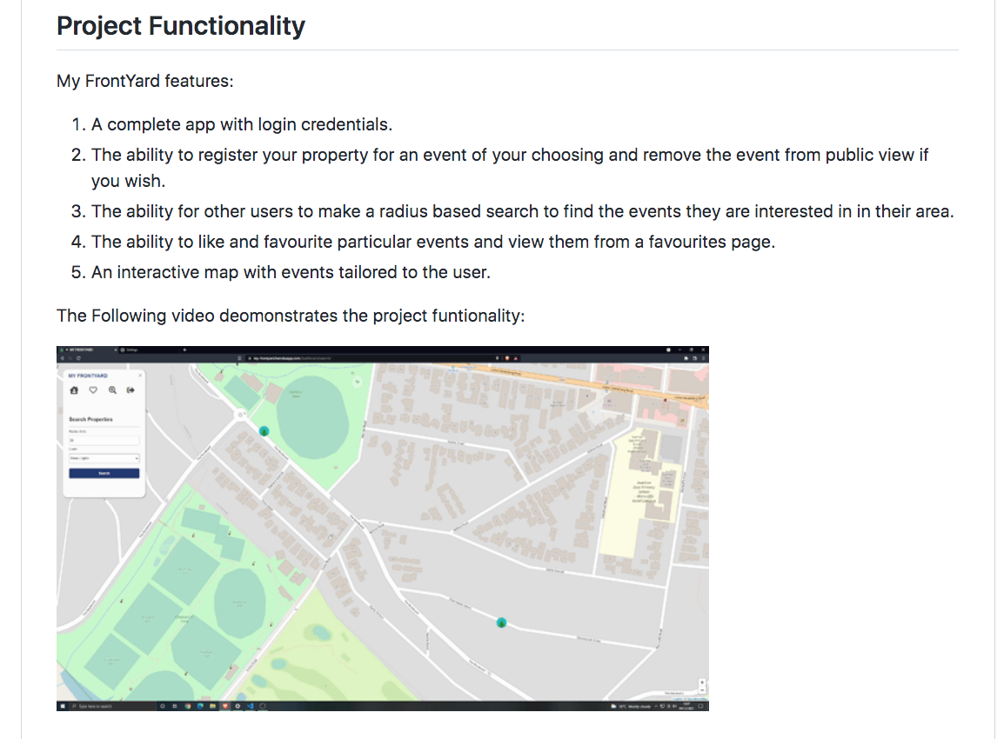

Slide 6
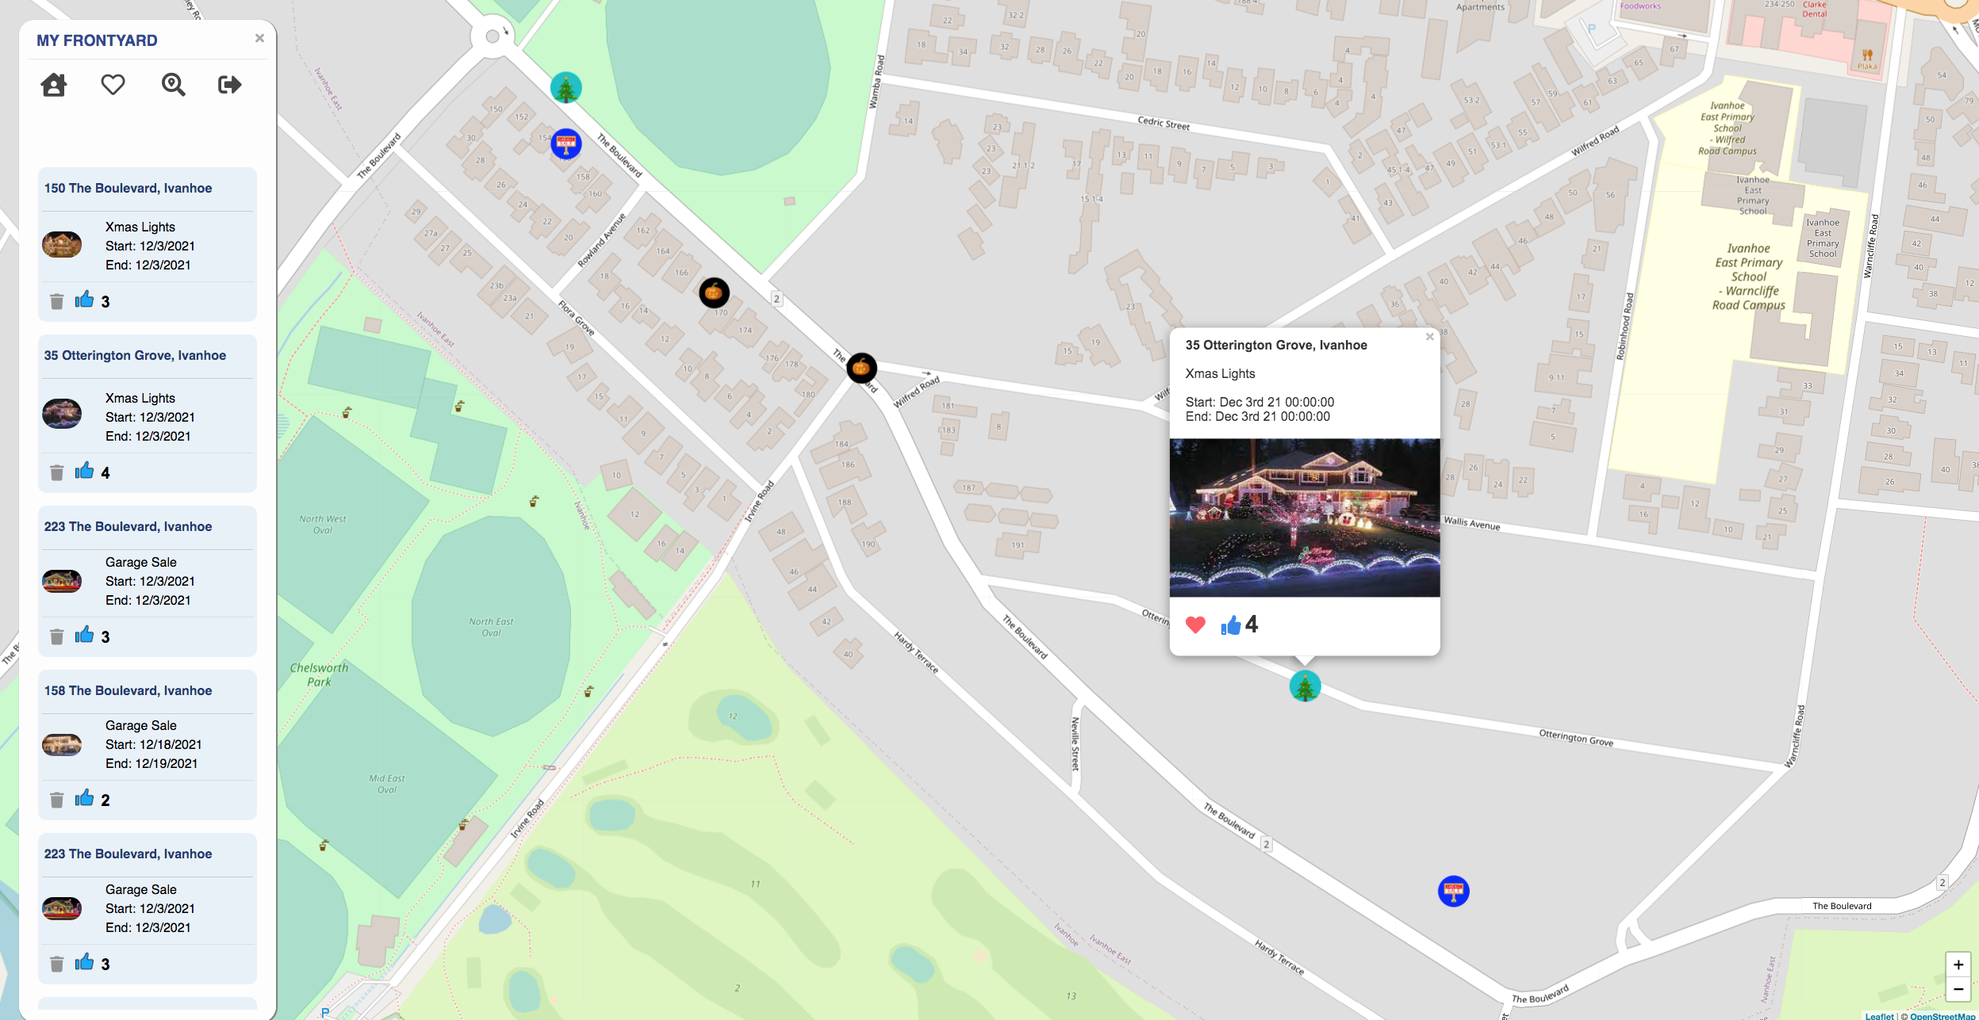
Built With
JavaScript
CSS
MySQL
Sequelize ORM
Node.js
Express.js
Handlebars.js
Heroku
JSON
Github
Third Party API's – Google GeoCode
Leaflet

Slide 7
